Slide 1
SWITCH ON/OFF HOME APPLIANCES USING ARDUINO THROUGH VOICE COMMANDS
Guide : Ms.Sreelekha.M
Presented By :Batch No.3
Team members:
Swalih.T
Shibilam.A
Shahana Shirin.P

Slide 2
INTRODUCTION
Bluetooth communication system.
It can be used in all fields like industry, domestic purposes like home appliances controlling.
Using Bluetooth as a remote.
This system reduces human negligence.
human
Labour,
effort,
time
and errors
due to

Slide 3
LITERATURE SURVEY
Design and Development of an Automated Home Control System Using Mobile Phone
A cell (mobile) phone acts as a modem.
The control of remote devices using mobile phones
Programmable interface controller (PIC) output.
-To control the switching of the

Slide 4
Ubiquitous Smart Home System Using Android Application
Android app communicating with the micro-web server
The Arduino Ethernet
Used to eliminate the use of a personal computer (PC)
Perform the smart home operations such as , switching functionalities
automatic environmental control Intrusion detection.

Slide 5
Zigbee Based Voice Controlled Wireless Smart Home System
The proposed system has two main components namely
voice recognition system
wireless system.
Control home appliances by using voice commands.

Slide 6
SURVEY COMPARISON REPORT
S. NO | METHODS | ADVANTAGE | DISADVANTAGE
1 | Design and Development of an Automated Home Control System Using Mobile Phone | Increased energy efficiency flexibility | More expensive Dependency on internet
2 | Ubiquitous Smart Home System Using Android Application | Maximizing home security Fast High efficiency | Short range Low data speed
3 | Zigbee Based Voice Controlled Wireless Smart Home System | Low Cost, Highly efficient Low power system | Data rate is low

Slide 7
PROPOSED SYSTEM
Lights, fans, TV, AC etc. can be controlled by use this project through Bluetooth wirelessly.
Other types of Automation Systems include Internet Controlled, RF Controlled or IR based Remote Controlled.
The main controlling component in the system is Arduino UNO.
The proposed system has mainly two parts, they are
Voice recognition system
wireless data transfer system

Slide 8
In this project controlling of home appliances are done by using a voice controlled android application.
It is easy for users to make use of remote access to control various applications.
Our system is a Arduino based system that can accepts voice commands and process them.
The system should be reasonably cheap, easy to configure and easy to use.
A Bluetooth model is interfaced with the control unit for sensing the signals transmitted by android application.

Slide 9
SOFTWARE & HARDWARE REQUIREMENT SPECIFICATION
ANDROID BASED PHONE
BLUETOOTH MODULE
ARDUINO UNO
RELAY

Slide 10
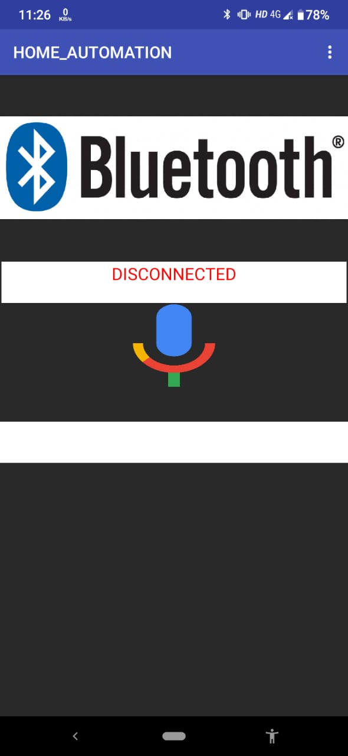
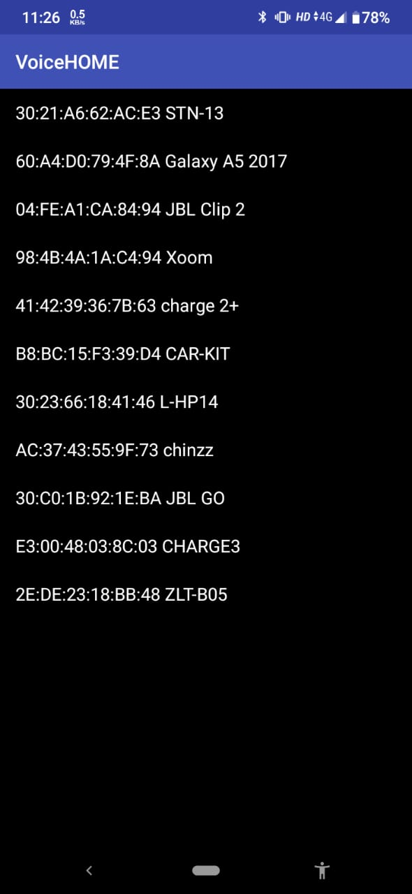
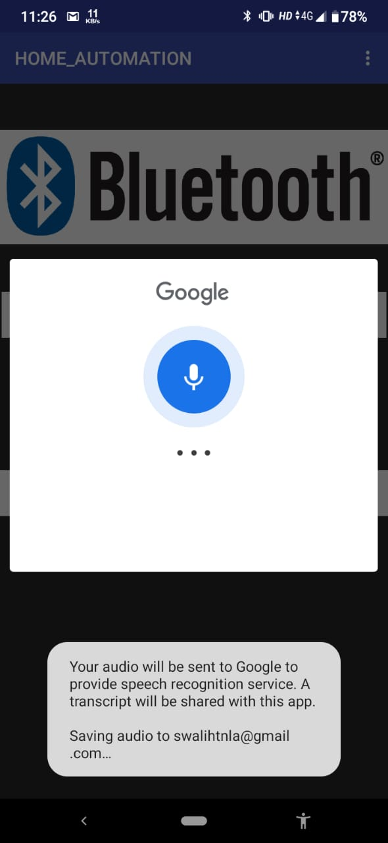
MODULES
ANDROID BASED PHONE :

Slide 11
open “voiceHOME.apk”
select bluetooth module and connect.
Then click on the mic icon to speak.
Send the voice command to the HC-05 module.
displays the given command in below textbox.

Slide 12
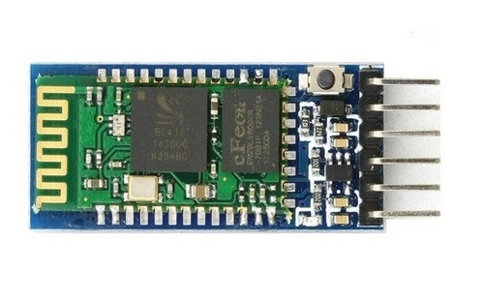
BLUETOOTH MODULE :
Bluetooth can operate in the following two modes either Command Mode or Operating Mode.
it is a device recieves information that have been transmitted from smart devices.
HC-05 module
.
ARDUINO UNO

Slide 13
ARDUINO UNO :
The Arduino/Genuino Uno can communicate with computer, or other Arduino boards.
It provides UART serial mode of communication.
Processes information as program developed.
Recieves and Transmits processed information from and to respective devices.(Bluetooth module)

Slide 14
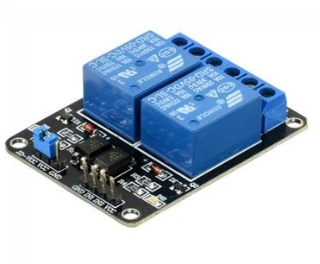
RELAY:
A electromagnetic relay is made of
A coil of wire wrapped around a soft iron core (a solenoid)
An iron yoke which provides a low reluctance path for magnetic flux
A movable iron armature
One or more sets of contacts (there are two contacts in the relay pictured)

Slide 15
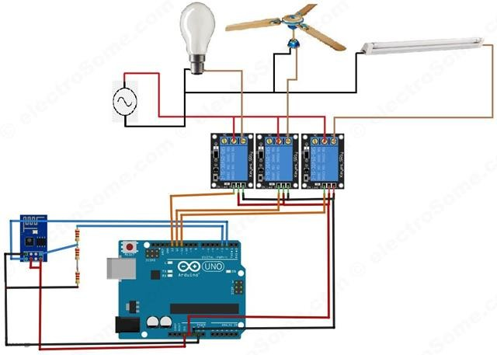
SYSTEM ARCHITECTURE

Slide 16
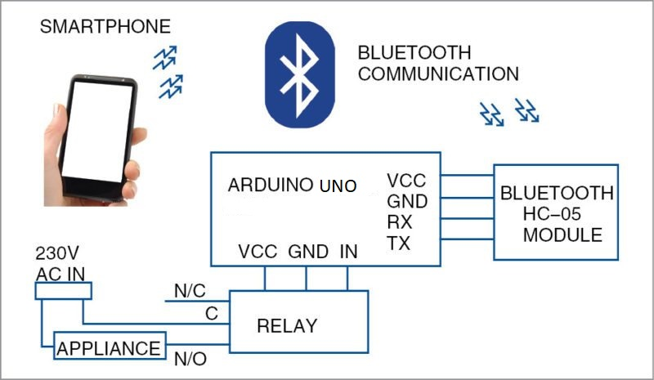
BLOCK DIAGRAM

Slide 17
WORKING
smart device(APPLICATION)
bluetooth module
ARDUINO UNO BOARD
Output Devices

Slide 18
WORKING EXPLANATION
SMART DEVICE(APPLICATION)
MIT APP INVENTOR is a google website where android applications can be developed.
Maintained by MASSACHUS ETTS INSTITUTE OF TECHNOLOGY

Slide 19
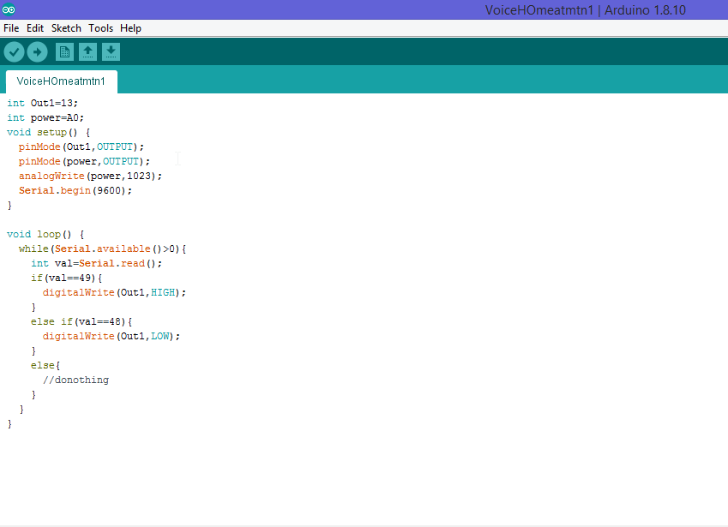

Slide 20
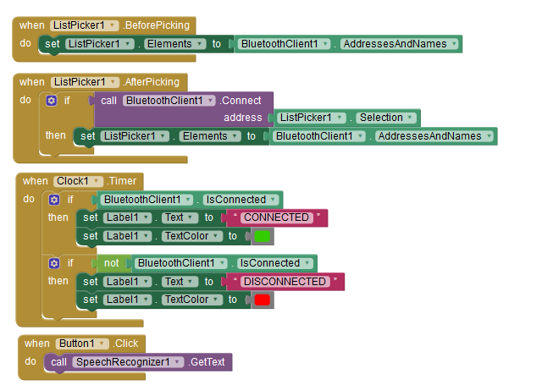

Slide 21
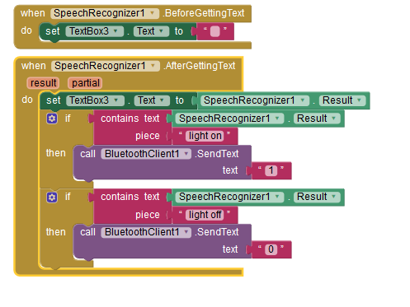

Slide 22
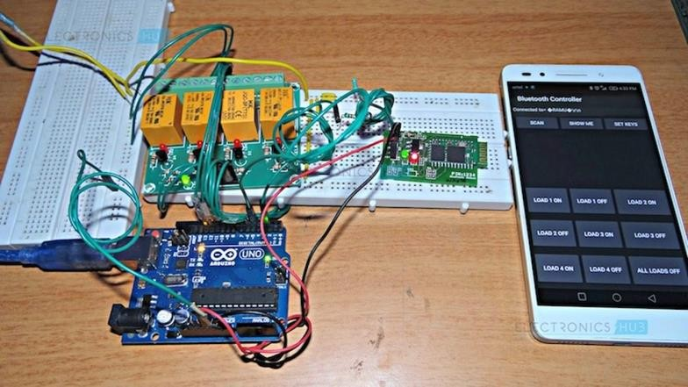
IMPLEMENTATION

Slide 23
The heart of the system is Arduino Uno which has a microcontroller i.e Atmega 328.
ISP program controller is used to program boat loader.
To control heavy AC loads relays are connected at the output pins of Arduino Uno.
Android is developed by Google .
The Arduino device along with the Bluetooth module and relay circuit needs to be connected to the switch board.

Slide 24
CONCLUSION AND FUTURE SCOPE
This system was targeted for elderly and disabled people.
It can yield maximum output with minimum complexity.
Voice system is a sensitive system.
Home automation based on voice recognition has been Buillt.

Slide 25
REFERENCES
Thoraya Obaid, Haliemah Rashed, Ali Abu El Nour, Muhammad Rehan, Mussab Muhammad Saleh, and Mohammed Tarique, “ZigBee based voice controlled wireless smart home system”, International Journal of Wireless & Mobile Networks (IJWMN) Vol. 6, No. 1, February 2014.
Alkar, A. Z., & Buhur, “Design and Development of an Automated Home Control System Using Mobile Phone”,U. (2005). An Internet Based Wireless Home Automation System for Multifunctional Devices. IEEE Consumer Electronics, 51(4), 1169-1174
Shiu Kumar,” UBIQUITOUS SMART HOME SYSTEM USING ANDROID APPLICATION “, International Journal of Computer Networks & Communications (IJCNC) Vol.6, No.1, January 2014

Slide 26
Dhawan S. Thakur and Aditi Sharma, “ Voice Recognition Wireless Home Automation System Based On Zigbee”, IOSR Journal of Electronics and Communication Engineering (IOSR-JECE) e-ISSN: 2278-2834,p- ISSN: 2278-8735.Volume 6, Issue 1 (May. - Jun. 2013), PP 65-75.
YunCui, MyoungjinKim, YiGu, Jong-jinJung, and HankuLee, “Home Appliance Management System for Monitoring Digitized Devices Using Cloud Computing Technology in Ubiquitous Sensor Network
Environment”,Hindawi Publishing Corporation International Journal of Distributed Sensor Networks Volume 2014, Article ID 174097.
Shih-Pang Tseng, Bo-Rong Li, Jun-Long Pan, and ChiaJuLin,”An Application of Internet of Things with Motion Sensing on Smart House“, 978-14799-6284-6/14 c ⃝ 2014 IEEE.
Kim Baraka, Marc Ghobril, Sami Malek, RouwaidaKanj, AymanKayssi,” SmartPower Management System For Home Appliances And Wellness Based On Wireless Sensors Network And Mobile Technology”, ,2015 XVIII AISEM Annual Conference, 978-1-4799-8591-3/15©2015 IEEE.

Slide 27
Thank You

